Slide 1
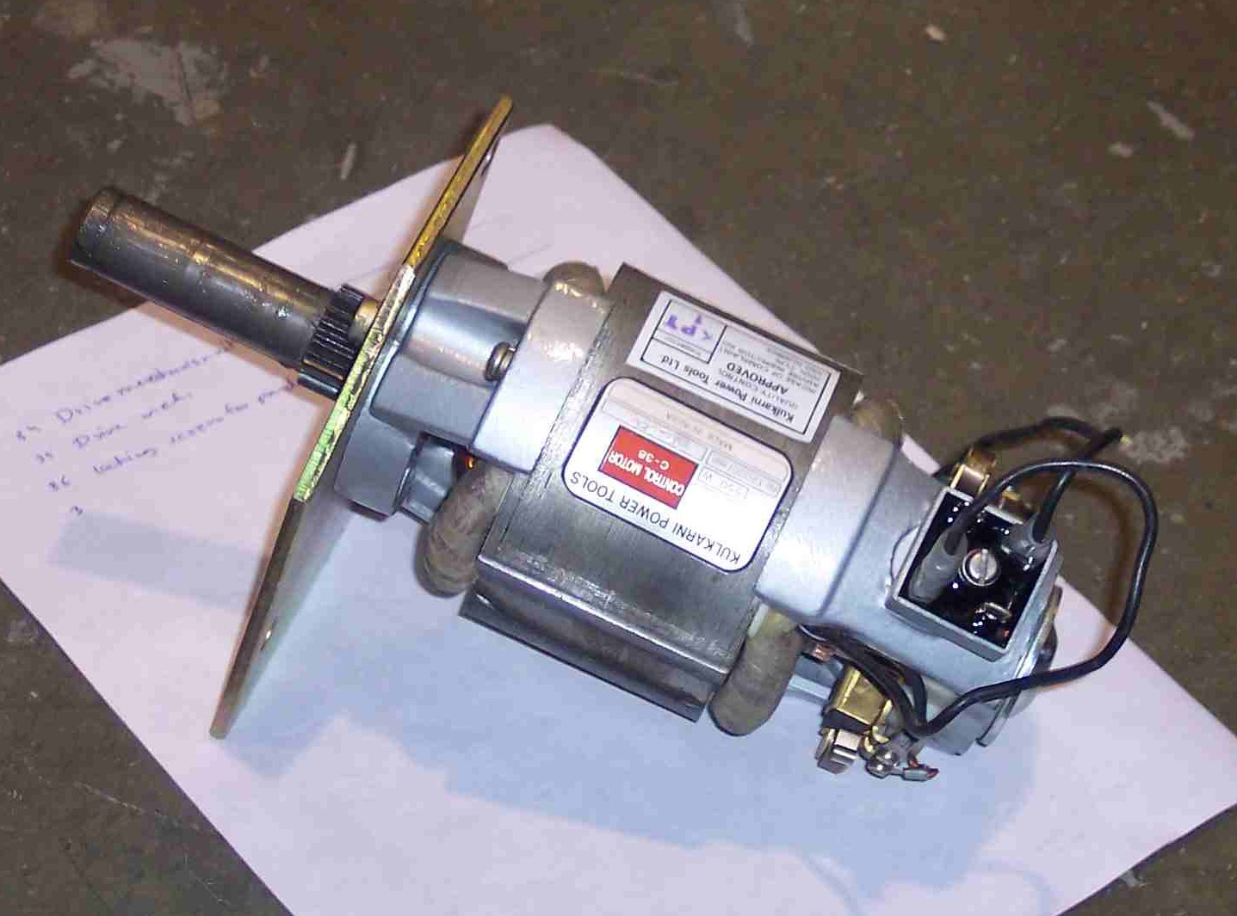
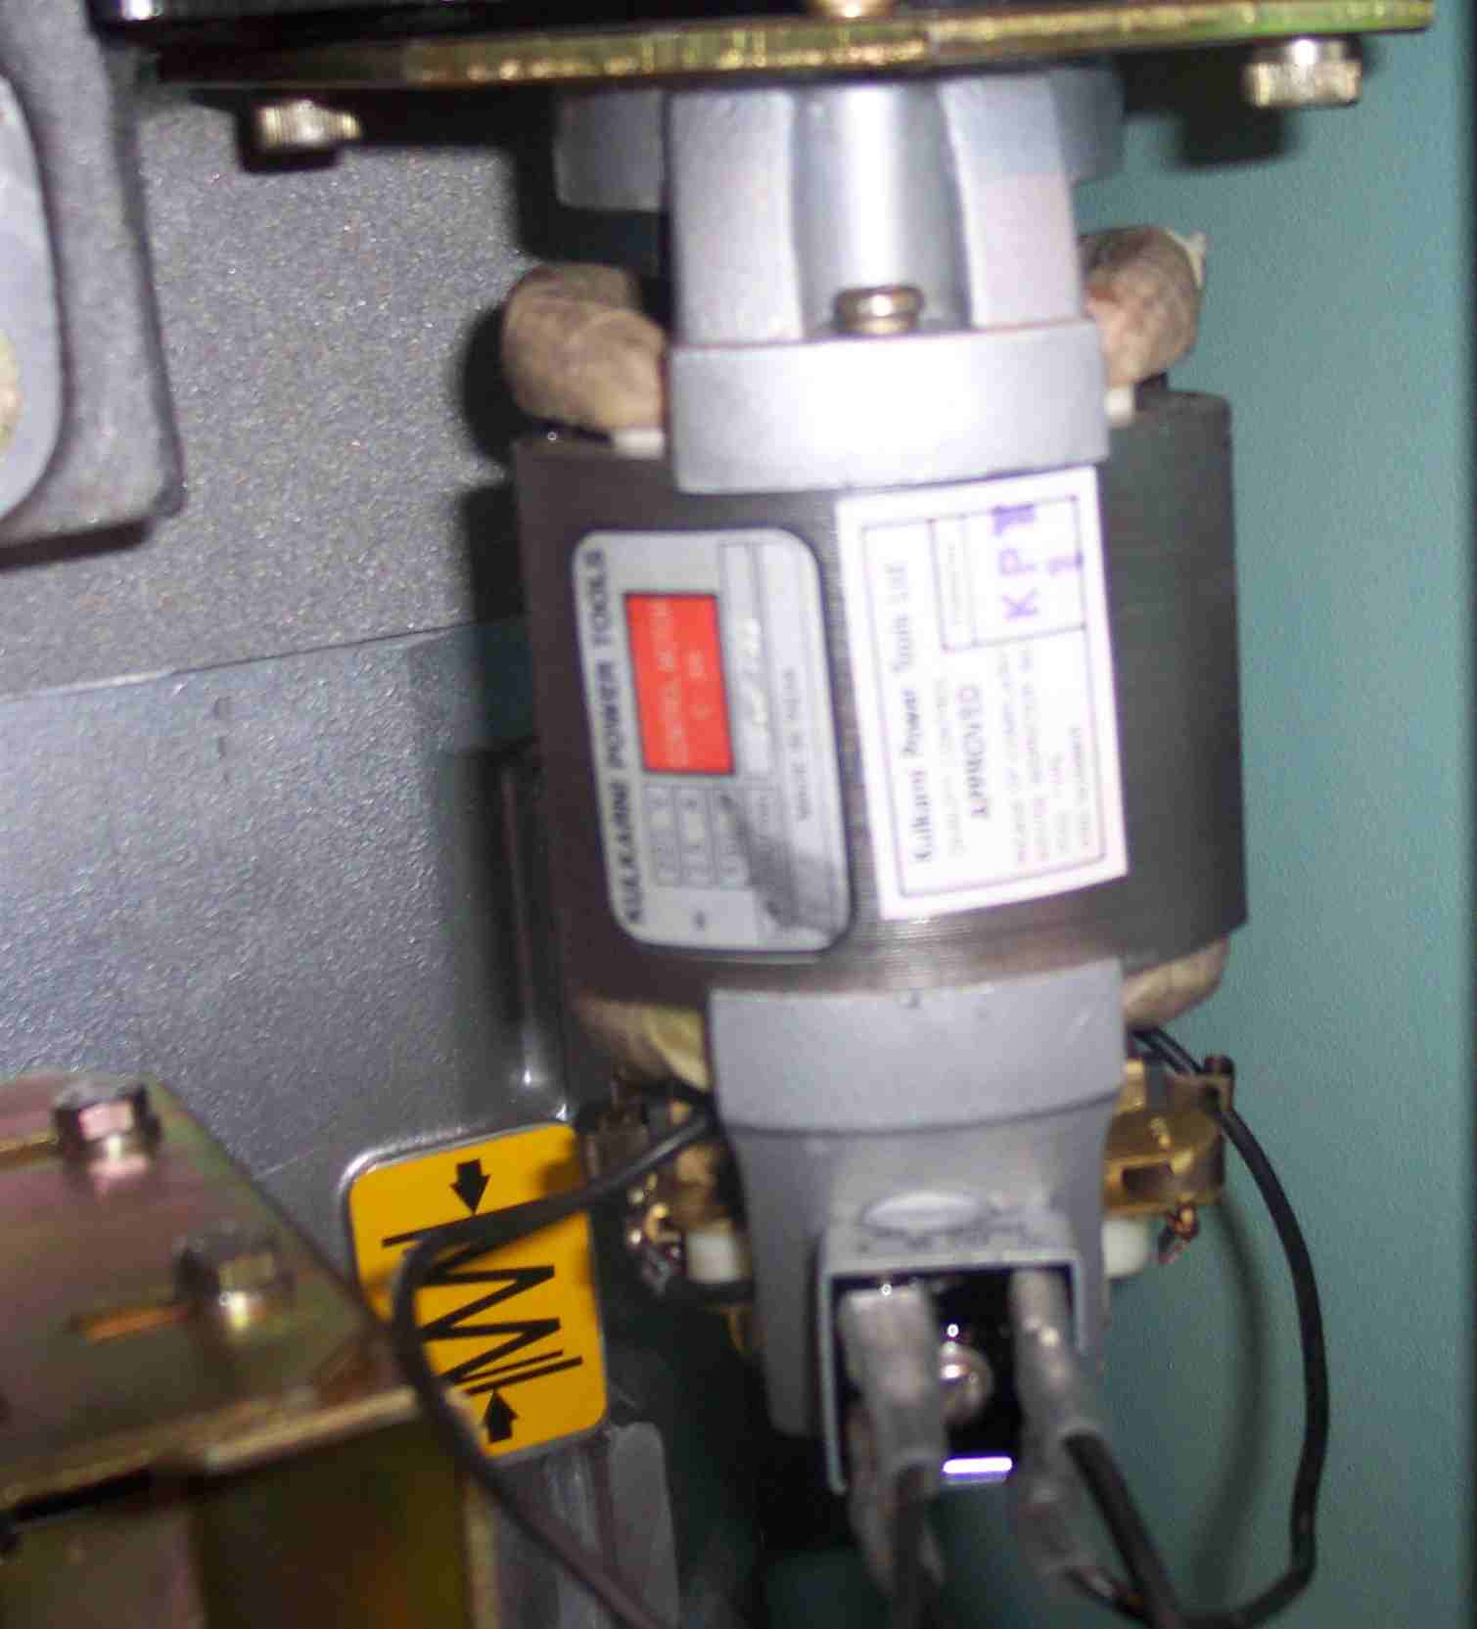
SIEMENS
HVCB SPARES
Spring Charging Motor assembly with rectifier
S4799084001

